Slide 1

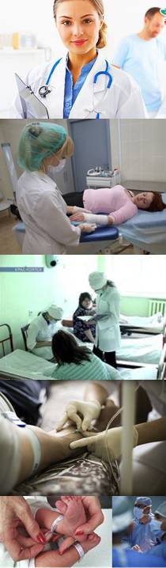
Educational Institution Grodno State Medical University
Organization of Educational and Clinical Practical Training of Students

Slide 2
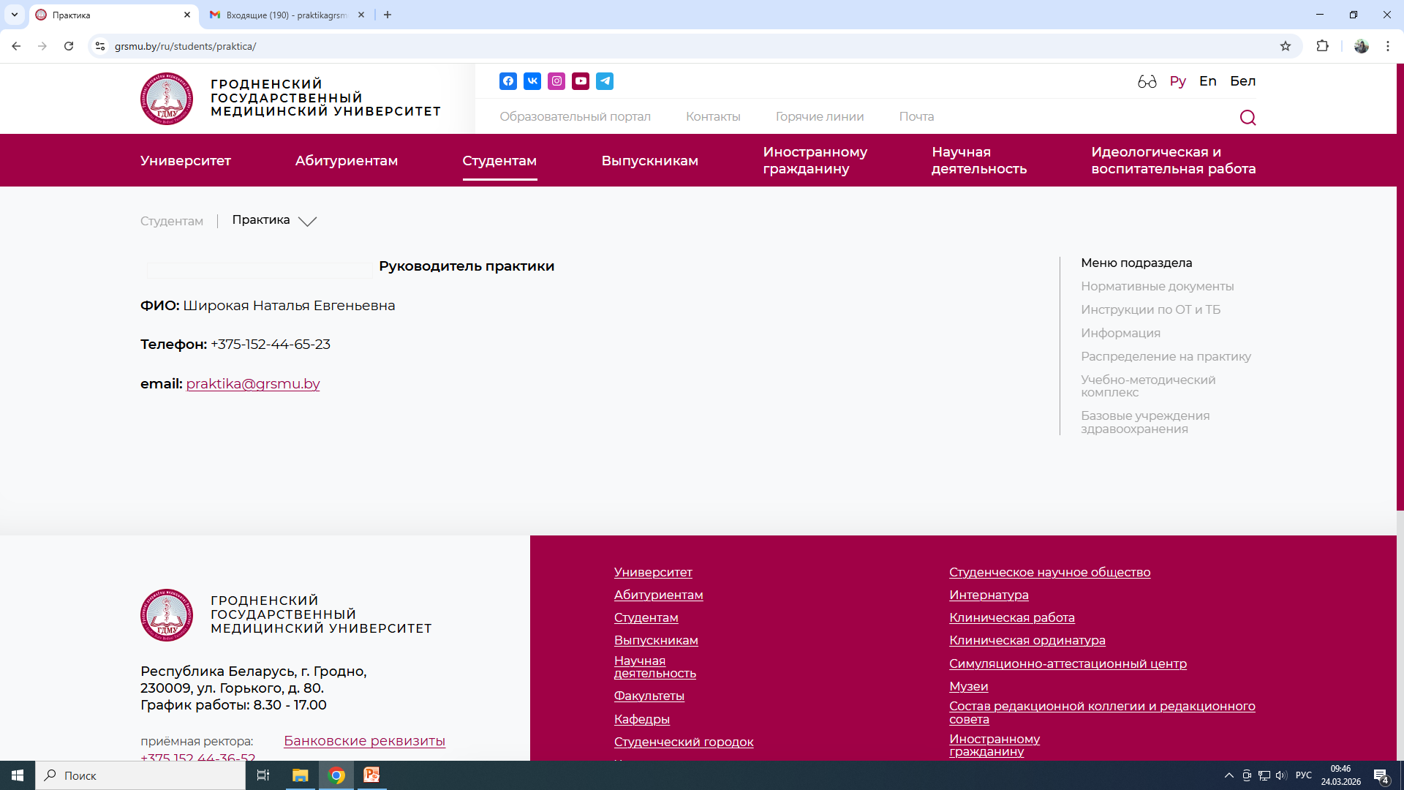
Practical Training Supervision
At the University, practical training supervisor is Shirokaya Natalya Evgenyevna . Regarding questions on practical training, students can visit room 231 from 2 pm till 5 pm. Email: praktika@grsmu.by
Notices on training are placed at the Dean’s office.

Slide 3
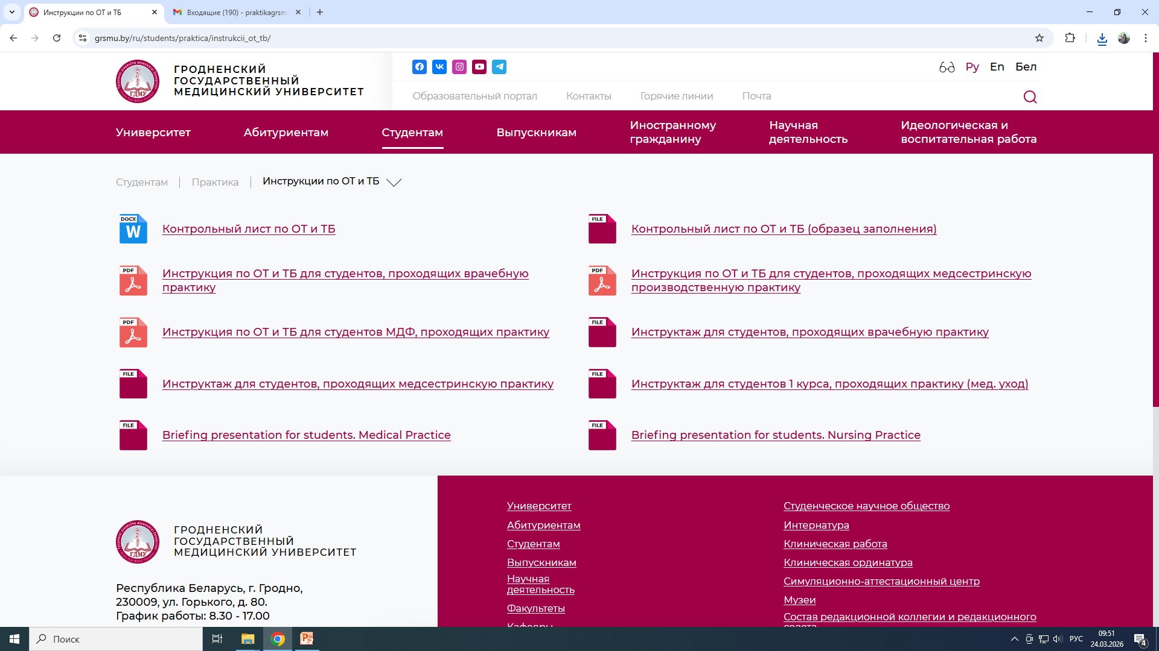
Instruction on labour protection and safety measures
Instruction on labour protection and safety measures are placed on the website (www.grsmu.by) as a presentation on the following pages: студентам → практика → инструкции по ОТ и ТБ. Before practical training, students must undergo the instruction (see the presentation) on labour protection and safety measures and sign the checklist on labour protection and safety measures (ОТ и ТБ). The leader of the group receives the list after the announcement at the Dean’s office.

Slide 4
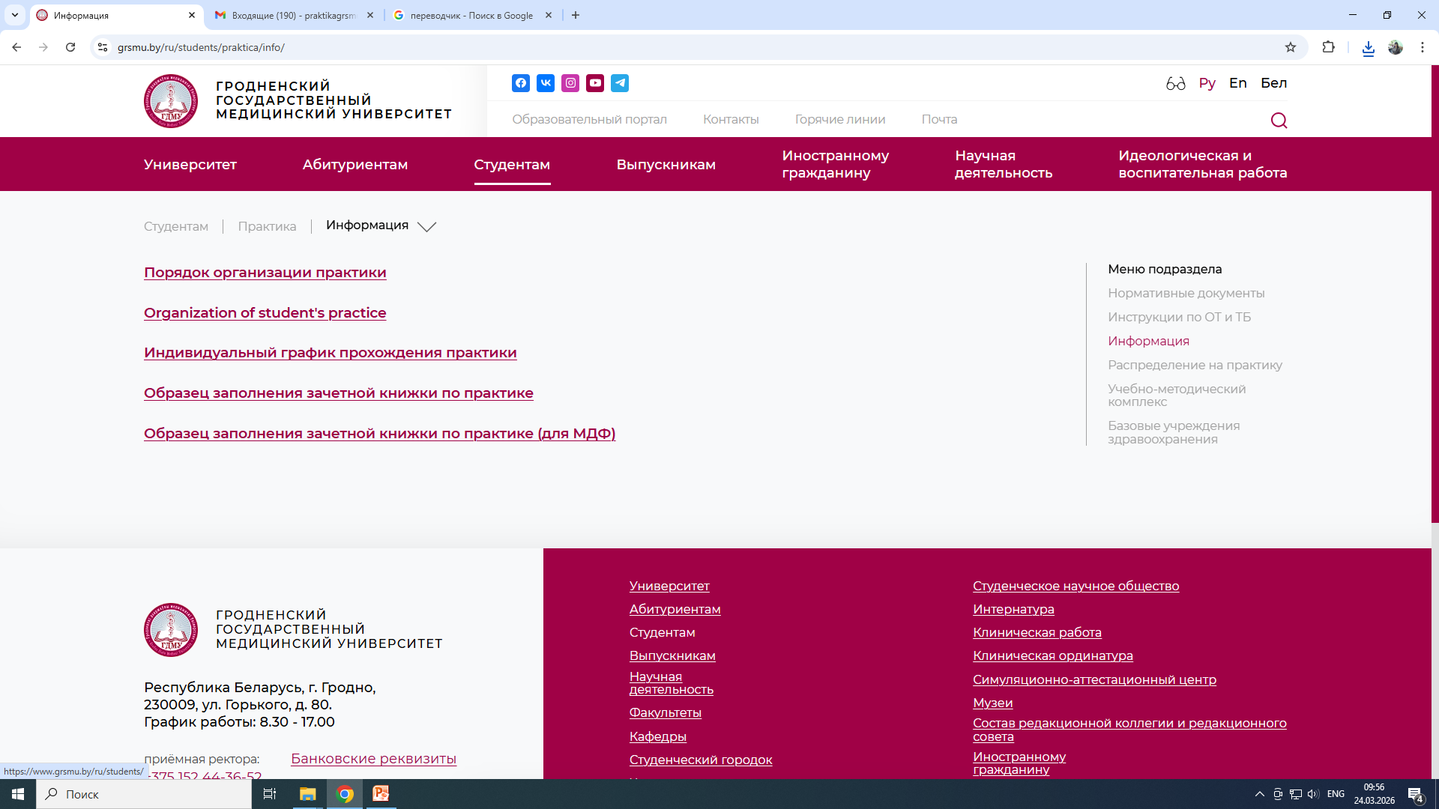
Practical Training Organization of Students at Educational Institution Grodno State Medical University
The list of students assigned for practical training and the cycles schedule are placed on the university website (www.grsmu.by) on the following pages: студентам → практика → информация

Slide 5
Practical Training curriculum
3rd year: Clinical Practical Training “Nursing” – a nurse’s assistant at procedure room, dressing room, wards.
Total – 216 hours, 144 of which at work place (72 hours in each cycle ):
  Cycle I - 10 days – therapy.
  Cycle II - 10 days – surgery.
4th year: Medical Outpatient Practical Training – a doctor’s assistant in outpatient hospital.
Total - 216 hrs, 144 of which at work place (20 days).
5th year: Clinical Practical Training – a doctor’s assistant in hospital.
  Total – 432 hrs, 288 of which are at work place (96 hours in each cycle):
  Cycle I – 15 days – therapy.
  Cycle II– 15 days – surgery.
  Cycle III – 10 days - obstetrics and gynecology.
Students working schedule at practical training:
5 hours (Mon-Fri) with 10 minutes break included
8:00 - 11:00 – 11:10 - 13:00

Slide 6
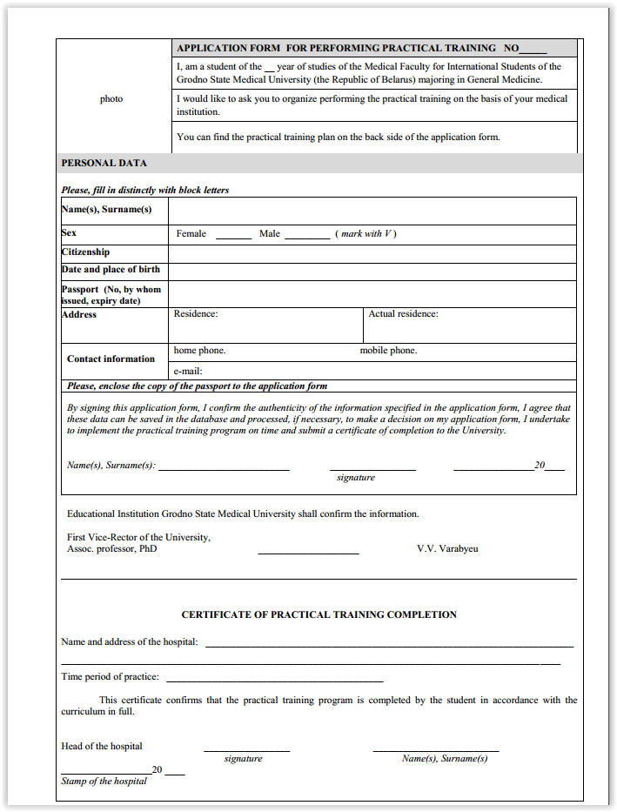
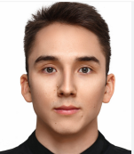
Practical training of international students of the Faculty outside the Republic of Belarus
Students of the Medical Faculty for International Students are allowed to undergo practical outside the Republic of Belarus under following conditions:
in the country, where a student wishes to undergo practical training, there needs to be a corresponding institution that provides all possibilities for obtaining practical skills according to the practical training curriculum (a guarantee letter from the institution needs to be submitted to the University);
after completing practical training, the head of the institution provides a certificate of practical training completion in the English language;
the certificate must be signed by the head of the institution (the head of the clinic) and sealed. In the certificate of practical training completion there should be the following information: name and address of the institution, where practical training was undertaken; the period of practical training; amount of hours (according to the curriculum of practical training).

Slide 7
Practical training of international students of the Faculty outside the Republic of Belarus
Before undergoing practical training outside the Republic of Belarus, students must:
inform the Dean’s office about the place of practical training on due time;
undergo medical examination and receive corresponding medical certificate;
receive the application form for undergoing practical training at the Dean’s office;
fill in the application and hand it in to the group leader who should submit it to the practical training supervisor of the University at room 231;
receive ready application for undergoing practical training and consolidated report (for the whole group) at the Dean’s office;
undergo instruction on labour protection and safety measures and sign the checklist (see the presentation on the website) ;
at differential credit on practical training submit reports on practical training (the application with the certificate and consolidated report) .
after the differential credit on practical training, the leader of the group hands in the applications to the supervisor of practical training of the University .

Slide 8
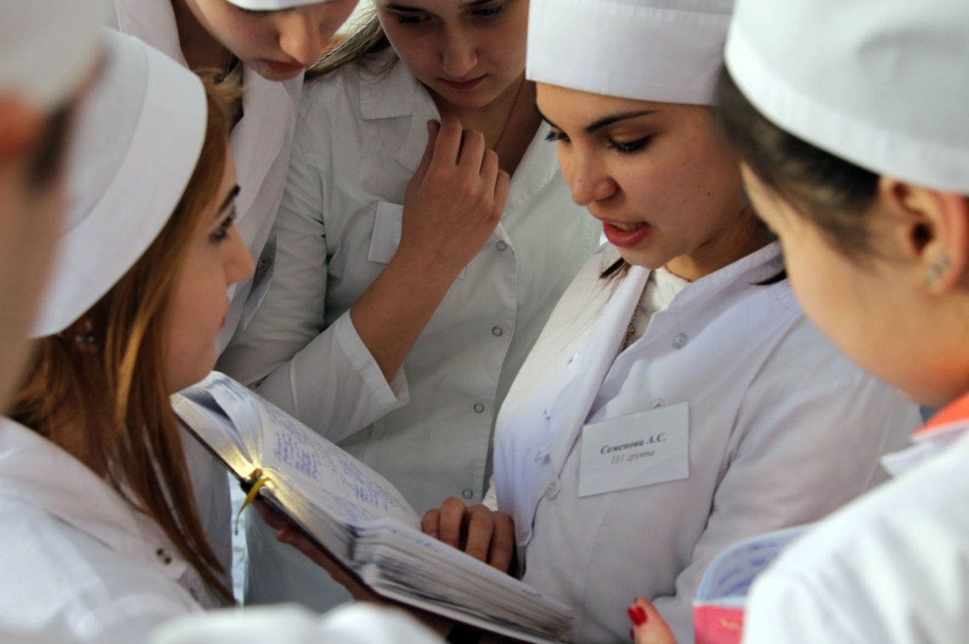
Students report on practical training
  Within practical training a student, under control of practial training supervisor at clinics (head nurse – for 3rd year students, the head of the department - for 4th and 5th year students), carries out training and reflects progress on training in the “Notes on practical training”, makes daily notes on work done, includes the date and time.

Slide 9
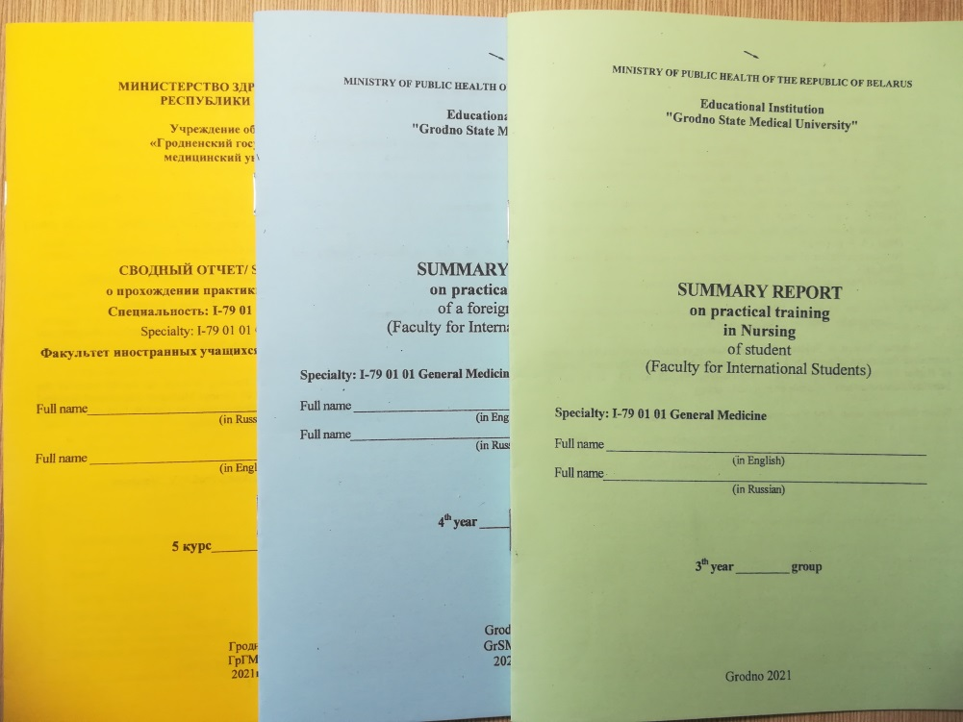
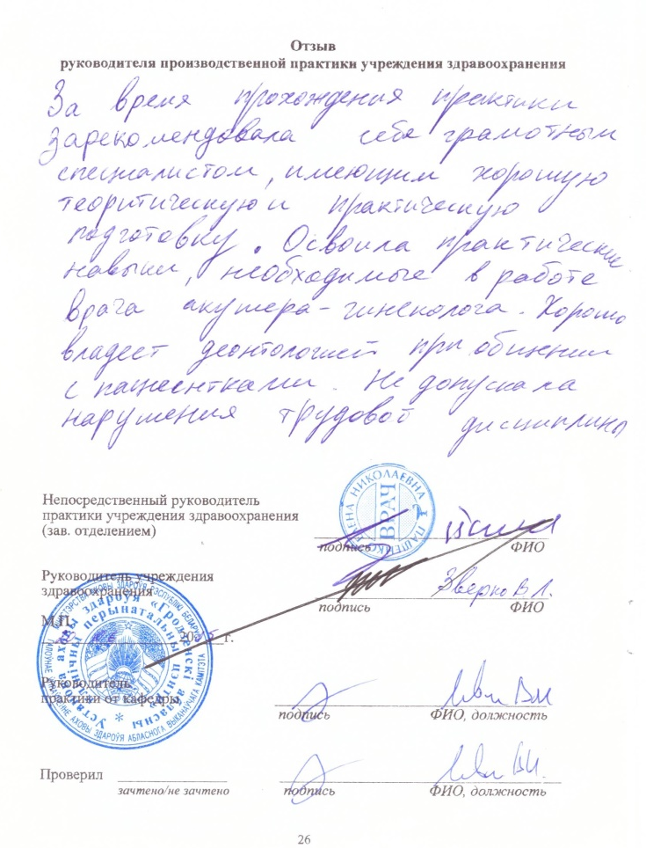
Students report on practical training
Within the last week of practical training students fill in “Consolidated report” on practical training that reflects all the work done (states number of performed practical skills). The number of performed practical skills students take from “Notes on practical training”.
At the end of practical training the practical training supervisor at clinic writes a review on a student’s performance in “Consolidated report”.
“Consolidated report” must be signed by :
the practical training supervisor at clinic;
the head (or the deputy) of the clinic ;
The report must be sealed.

Slide 10
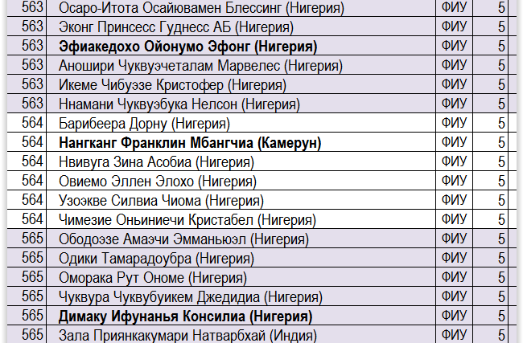

Duties of the leader of practical training group
(in the list for practical training is written in bold, appointed by the Dean)
informs the group about updates on practical training;
on due time informs the supervisor of practical training at clinic and the teacher of the department in case a student is absent or disobeys discipline rules;
at the end of training hands in “Consolidated report” of students to the supervisor of practical training at clinic and have it sealed.

Slide 11

Within practical training students must
undergo medical examination before practical training;
undergo instructions of labour protection and safety measures and sign the checklist (see the presentation on the website) ;
receive “Consolidated report” on practical training from the group leader;
start practical training on due time:
on the first day of practical training, students appointed for practical training outside of Grodno need to go to the base (clinic) of practical training to the Human Resources department at 8.30 am;
on the first day of practical training, students appointed for training in Grodno must go to the meeting on practical training according to the schedule (see the schedule on the eve of practical training).
Students must have:
Student card;
Medical certificate;
Medical robe (surgical robe for the cycle “Surgery”);
Shoes to change (medical);
Medical cap, mask, gloves;
Stethoscope (for 4th and 5th year students);
“Consolidated report” on practical training and notebook (worksheet).

Slide 12

Within practical training students must
learn and follow rules on labour protection and safety measures;
undergo practical training within the time frame stated in the curriculum;
follow internal rules of the base (clinic) of practical training;
perform tasks stated in the program of practical training thoroughly and actively ;
be responsible for the work done and its results ;
follow principles of professional ethics and deontology ;
fill in “Consolidated report”;
submit “Consolidated report”, the application with the certificate to the teacher at the deferential credit ;
pass the deferential credit on practical training on due time .

Slide 13
Making up missed days of practical training
Making up of missed days for valid or invalid reasons is performed without reducing of working hours on evening or on weekends before the end of practical training.
Students plan the schedule for making up of missed days with the supervisor of practical training and supervisor of practical training of the department.
If students don’t manage to make up the days before training ends, terms of practical training are rescheduled. For that, students address the supervisor of practical training of the University.

Slide 14

Medical Confidential Information and Students Ethical Code of Educational Institution Grodno State Medical University
Medical confidential information - is personal information that a patient passes to a doctor.
This information is :
asking for medical help;
physical and mental condition of the patient;
diagnosis and prognosis;
any other data told by the patient or learnt within examination or treatment .
All information in medical records also belongs to medical confidential information.
Students must learn and follow Ethical Code of the Educational Institution Grodno State Medical University (www.grsmu.by)
It is not allowed to disclose information that belongs to medical confidential information by people who learnt this information during studying process/ undergoing practical training, performing professional, official and other duties.

Slide 15
BADGE REQUIREMENTS
sample
Basic requirements and standards:
Language: Russian
Content: Student's full name, year, department, and name of educational institution.
Location: Collar area, right side of chest.
Design: Use simple fonts; information should be easily readable from 1-2 meters away.
УО «ГрГМУ»
Full name (in Russian)
студент-практикант
5 курс
факультет иностранных учащихся
GrSMU
Full name
Student-Intern
5th year student Faculty of International Students

Slide 16
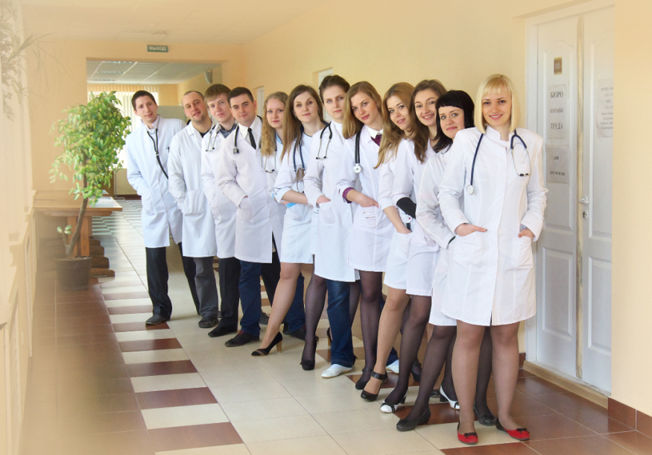
Good luck with practical training!
Supervisor of practical training
Shirokaya N. E.

