Slide 1
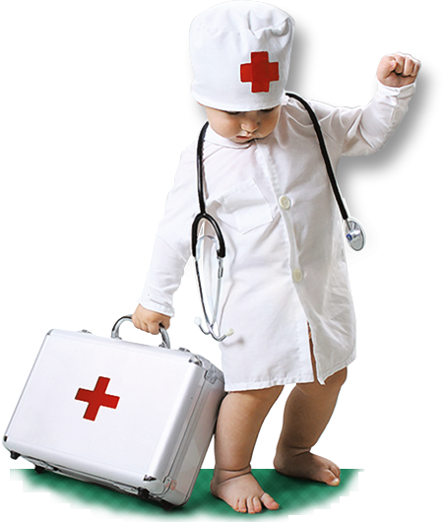
Are you going to practical training?
You should be informed
of Fire Safety
Measures!

Slide 2
Within a practical training, a student is obliged to:
follow Health and Safety Procedures and Rules of Internal Order at medical higher institutions as well;
be aware of main destroying and harmful conditions, appearing within a practical training;
be aware of preventive and protective measures against destroying and harmful conditions;
correctly use and apply personal or group protective equipment;
be aware of and follow Fire Safety Measures and fire emergency procedures;
inform immediately supervisor or an official, replacing a supervisor if any emergency situation has been appeared.

Slide 3
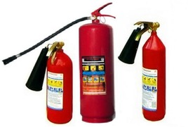
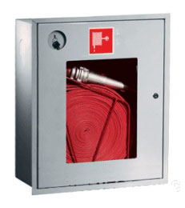
Escape route
Fire extinguisher
Fire-cock (plug)

Slide 4
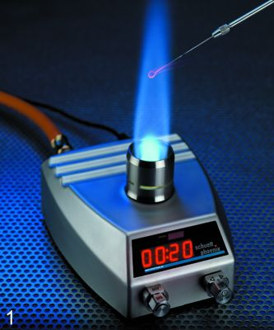
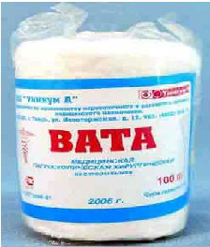
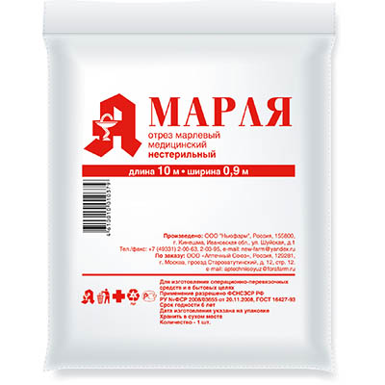
To prevent the fire:
Do not leave turned-on gas-jets or other heating devices unsupervised.
It is forbidden to put cotton wools, gauze fabrics, diethyl hydrine close to gas-jets.

Slide 5
If you detect gas odor,
Do not switch on or off the light;
Do not fire up and smoke;
Do not use electric heating devices;
Air the premises;
Dial 104.

Slide 6
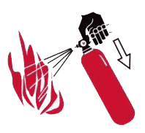
If the fire starts,
Inform a supervisor;
Call for the fire brigade;
Supress a fire using emergency fire-fighting equipment

Slide 7
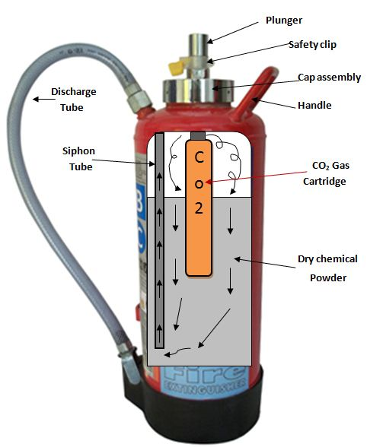
Dry powder fire extinguisher
is used to suppress solid, liquid and gaseous substances and electric devices voltaged up to 1000.

Slide 8
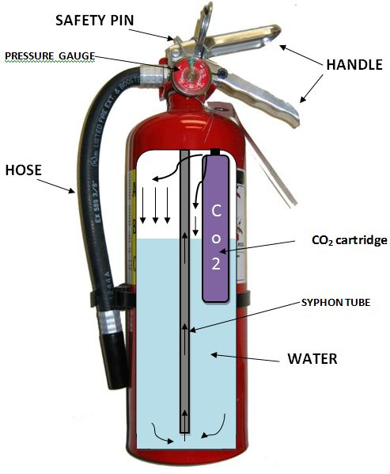
Carbon-dioxide fire extinguisher
is used to suppress different substances and fabrics and electric devices, cables voltaged up to 10000.

Slide 9
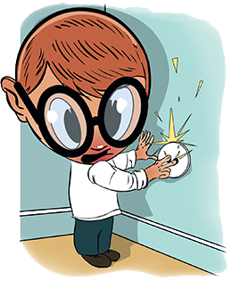
Electrical Safety Requirements:
Do not insert a foreign object into a wallplate;
Do not bend wires;
Do not hang something
on power line;
Do not carry switched-on
electric devices.

Slide 10
Labour Protection Requirements for treatment (procedural) room work

Slide 11
When giving remedies
Wash carefully hands;
Attentively examine a doctor’s prescription;
Be sure all remedies are wrapped in original packs;
Check the sell-by date.

Slide 12
It is absolutely forbidden to smell
or taste remedies.
Do not allow strangers use remedies.
Do not leave remedies unsupervised.

Slide 13
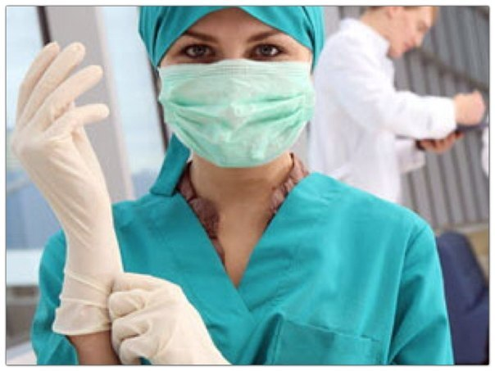
Attention!
Each patient should be considered like potentially infected and given appropriate precautions.

Slide 14
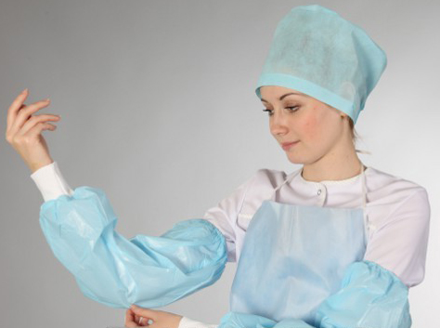
While making analyses withdrawals
or making injections should use:
sanitary-hygienic clothes:
lap coat;
cap;
pinafore;
oversleeves.
personal protective equipment:
gloves;
mask;
protective glasses.

Slide 15
Hands
No accessories (rings, bracelets) should be.
Nails should be shortly cut.
All injuries should be covered with a plaster or fingerstall.
Hands should be washed after a procedure twice .

Slide 16
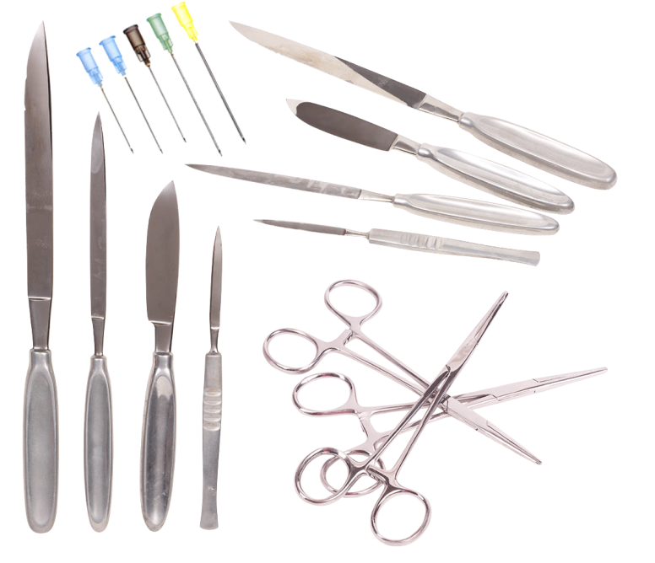
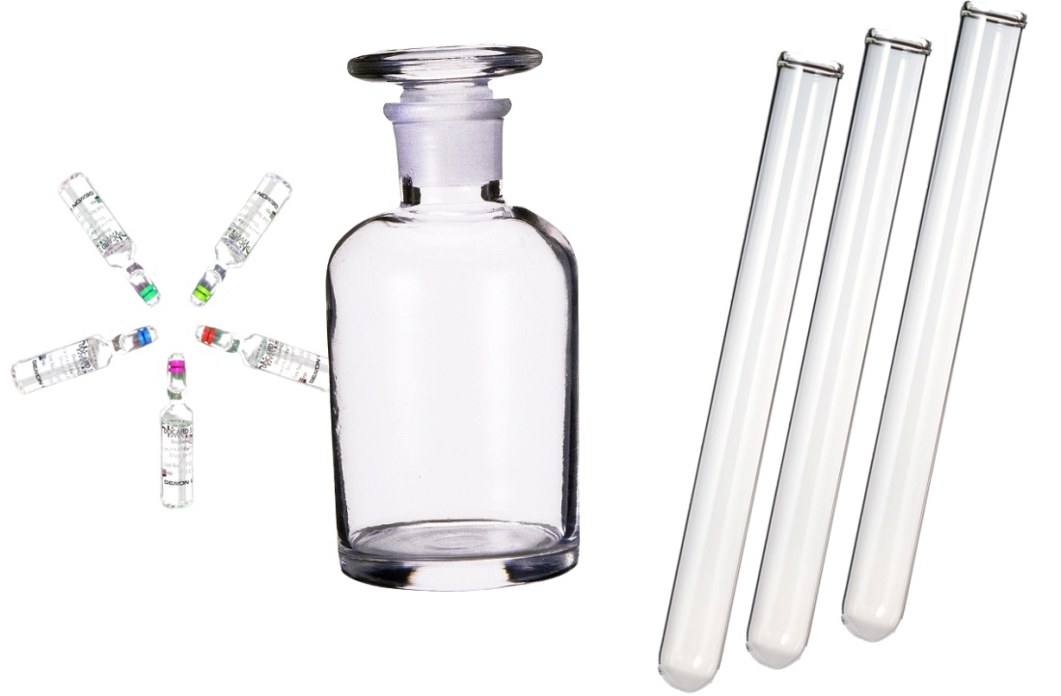
Be attentive
With work of piercing and cutting objects (needles, scalpels, scissors, etc.)
With work of glass dishes
(ampules, bottles,
vials,
test-tubes, etc.)

Slide 17
While making injections:
Check notes in a register;
Wash hands;
Take on the gloves;
Attentively read a remedy label;
Check the sell-by date.
Carefully open an ampule or bottle.

Slide 18
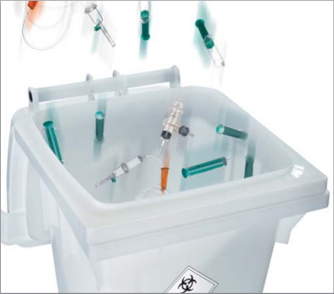
Disposable articles (articles used only once)
antlia,
Medical dressing,
gloves,
masks
should be utilized.

Slide 19
Actions due to emergency situations in treatment (procedural) room

Slide 20
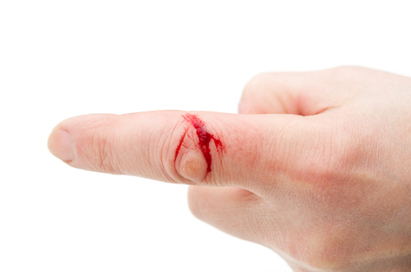
Skin lesions
Wash hands with a soup without removing gloves;
Remove gloves;
Do not stop blood within several seconds
Use 70% diethyl hydrine
Then use 5% iodine alcoholate
Use plaster
Take on a fingerstall if you have a finger wound.

Slide 21
If an infected substance gets onto:
skin
Wash with water and soup
Use 70% diethyl hydrine
Do not scrape
eyes
Use 0,9% sodium chloride using antlia
Drop 20% sodium sulfate liquid
oral cavity
Gargle using 70% diethyl hydrine

Slide 22
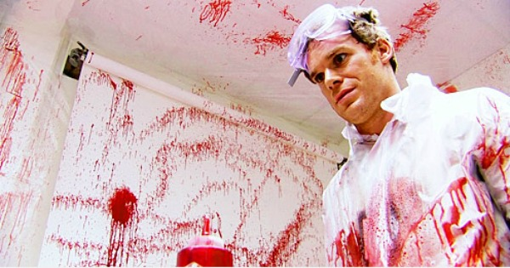
Protective clothes
Remove it
Bedabble it using sodium chloride – wash it in a washing machine
shoes
Twice use sodium chloride with 15 minutes break
Floor, walls, furniture and other things
Use sodium chloride
Wait 30 minutes
clean

Slide 23
Labour Protection Requirements for work with oxygen gas

Slide 24
«Attention – Oxygen!»
Being in premises with elevated oxygen rate and going off 30 minutes after is forbidden to:
use open fire;
smoke;
use electric devices with an open swirl;
store flammable gases and liquids.

Slide 25
Follow these ordinal rules you will avoid emergency situations and save your
health.

