Slide 1
Good Manners of Behaviour

Slide 2
Leave your over wear (overcoats, outer clothing) in the cloakroom.
Keep calm and silence, no loud laughing, shouting and speaking in the library, reading room, classrooms, corridors, any office, and the canteen (University cafeteria), hostels. Don’t make terrible noise in apartments.
Greet all people while in the University.
Treat your textbooks carefully, keep them clean and tidy.

Slide 3
ATTENTION
Many cases of unacceptable handling of our textbooks have been observed.
Keep in mind that if you don’t handle our books properly you must compensate their cost.
In the most inappropriate cases, you will be forbidden to obtain books for the next academic years.
Note that if you don’t handle books properly, junior students might not receive them at all.

Slide 4
Always have you student’s identification card (ID) with you. It’s your pass!
Don’t leave your bags, school bags, rucksacks, packets and any other things without control, supervision and care.
Cross streets by light signal (traffic light) and in due place – zebra crossing
Punch a ticket in buses and trolleybuses in case if you don’t have a monthly ticket.

Slide 5
ATTENTION
It is strictly forbidden to leave your bags and suchlike belongings on windowsills, at the Dean’s office door, in the corridoor, halls and anywhere else in the university buildings without any surveillance (control).
Keep in mind that in case of belongings left without any surveillance (control), we have to call special services (due to antiterroristic measures). In this case, if no danger is present, you have to pay the large penalty for false alarm and will be reprimanded!

Slide 6
Keep your rooms and kitchens clean and tidy. Clean away a mess and throw away rubbish (garbage) regularly.
Switch off you electric cookers after cooking as well as other electric devices (allowed)! Don’t leave meals being cooked without control!
Switch off electric light in all your premises leaving them, don’t lose your money; electricity is too expensive.
No drinking in hostels and anywhere!
No smoking in the hostels and near
the University.

Slide 7
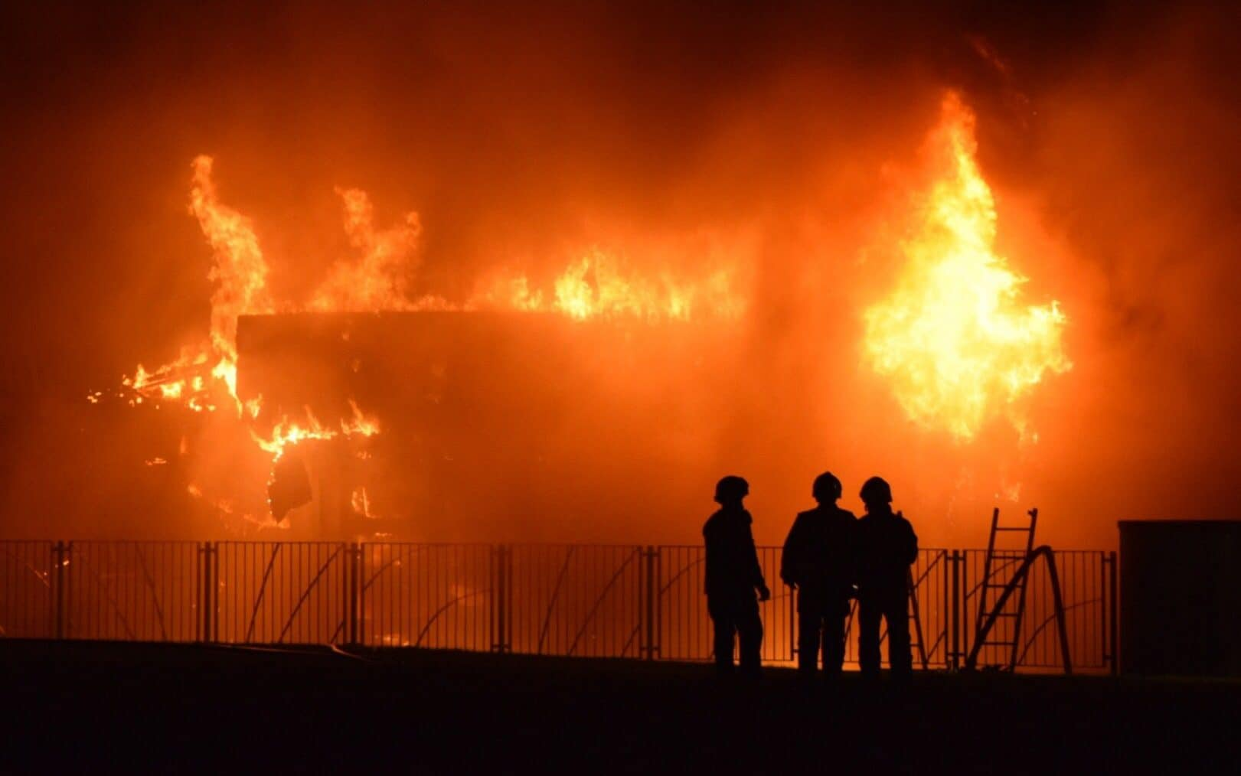
ATTENTION
It is forbidden to leave switched on devices uncontrolled.
Such cases can lead
to accidents and
in worst situations
to catastrophes.

Slide 8
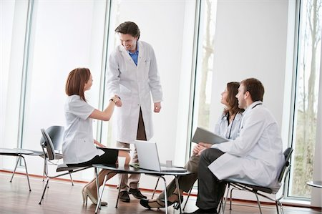
Treat the Dean’s office personnel with respect.
Be always well-dressed, washed and good looking, put on a perfectly clean medical gown.
Have always changeable
footwear at the clinical
departments

Slide 9
Remember that you are future doctors!

