Slide 1
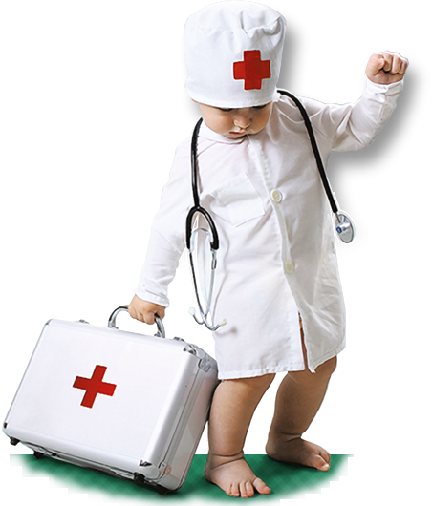
Are you undergoing practical training?
First undergo safety instructions

Slide 2
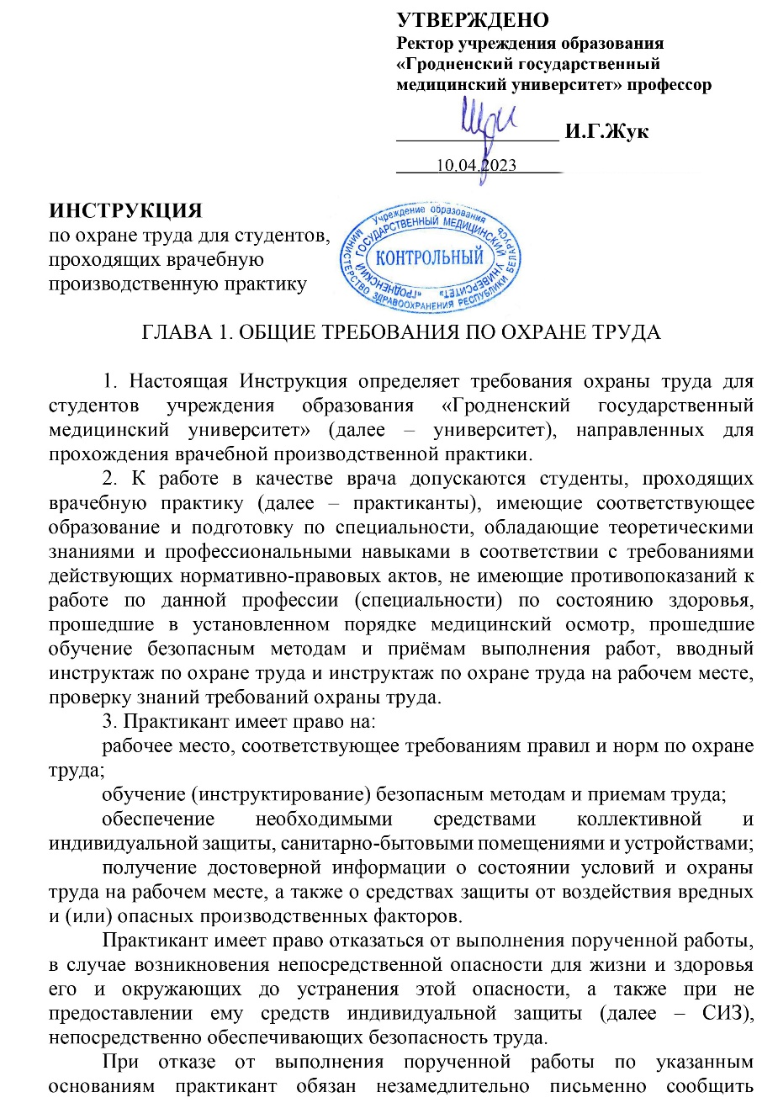
Study the instruction on labor safety at the University website, page “Practical training”

Slide 3

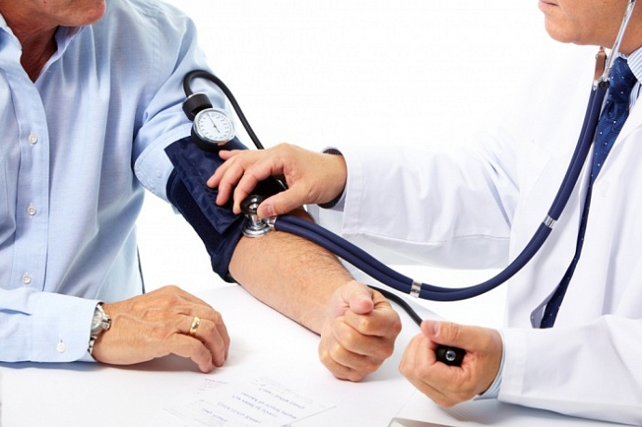
Persons allowed to undergo practical training:
18 years old and older;
with corresponding education and training;
undergone medical checkup, without any medical contraindications;

Slide 4


Undergone the introductory labor safety training
Undergone the primary training on labor safety at workplace

Slide 5
AT TRAINING, A STUDENT IS ELIGIBLE:
to have a workplace corresponding to the requirements of labor safety;
to be educated on safety methods and approaches to work performance;
to be provided with necessary protective equipment;
to receive reliable information on conditions and labor safety at the workplace, on harmful and (or) dangerous workplace factors, protective means against their effects;

Slide 6

AT TRAINING, A STUDENT IS ELIGIBLE:
to refuse to perform assigned tasks in case of a danger to own and others life or health until the danger is eliminated, and if personal protective equipment (PPE) that ensure safety of work is not provided .
If you refuse to perform assigned tasks due to the reasons above, submit a written notice to the supervisor where you mention the reasons for refusal, but perform other assigned tasks.

Slide 7
AT TRAINING,
A STUDENT MUST:
follow the labor safety requirements as well as rules of behavior on healthcare institutions’ territory;
know main harmful factors that can arise at practical training as well as preventive and protective measures against them;
use and apply personal and collective protective equipment correctly;

Slide 8
AT TRAINING,
A STUDENT MUST:
care for own safety and health as well as for safety of others while working or while on a healthcare institution’s territory;
know and follow the requirements of fire safety measures, the procedure in case of fire;
inform the supervisor about any life or health threatening situation, accident immediately.

Slide 9


It is unacceptable to be at the workplace in a state of alcoholic intoxication or in a state caused by narcotic substances, psychotropic or toxic substances, as well as to drink alcoholic beverages, take narcotic drugs, psychotropic or toxic substances at the workplace or within working hours.

Slide 10
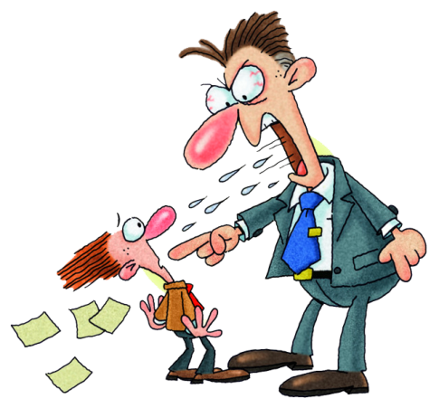


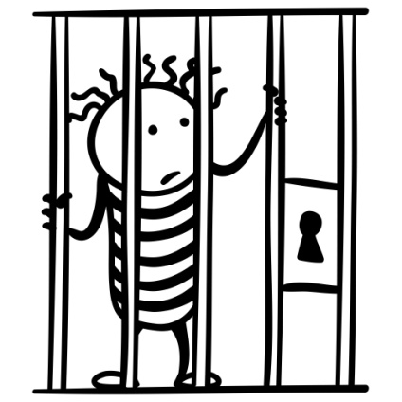
LIABILITY for violation of labor safety requirements
Disciplinary
(warning, reprimand, discharge)
Material
(compensation for damage)
Administrative
(fine, penalty 0,1-30 of baseline rate)
Criminal
(penalty, imprisonment for 2-7 years)

Slide 11
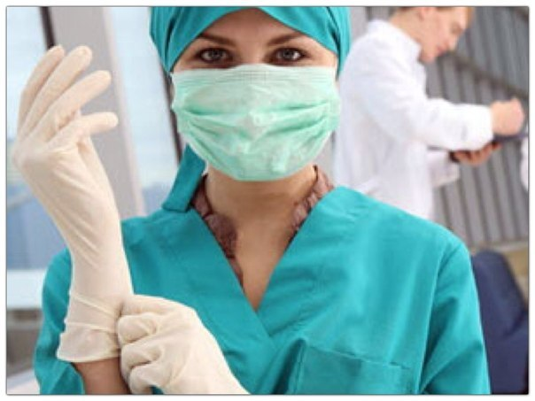
Before work a student must:
put on sanitary clothes and
shoes that should be clean
and do not constrain
motion.
It is not allowed to pin the
clothes with needles, store
pins, keep glass and sharp objects in pockets.
examine and clean the workplace. Remove unnecessary objects that may interfere with the work or create an additional danger.

Slide 12
In case of malfunctions or failures of equipment
Report this to your immediate or superior supervisor.
Do not independently fix failures related to repair and adjustment of equipment. Repair of equipment is carried out only by specialists.
Do not start work until the problem is fixed.

Slide 13

Hands
No accessories (rings, bracelets)
Nails should be shortly cut
All injuries should be covered with a plaster or fingerstall

Slide 14
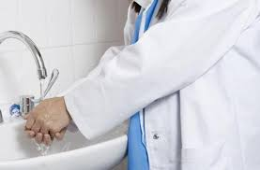
WHEN WORKING:
It is necessary to wash your hands in warm water with soap, and if necessary – apply a disinfectant after each case of treating patients, contact with discharge from patients, dirty linen
or dishes.

Slide 15
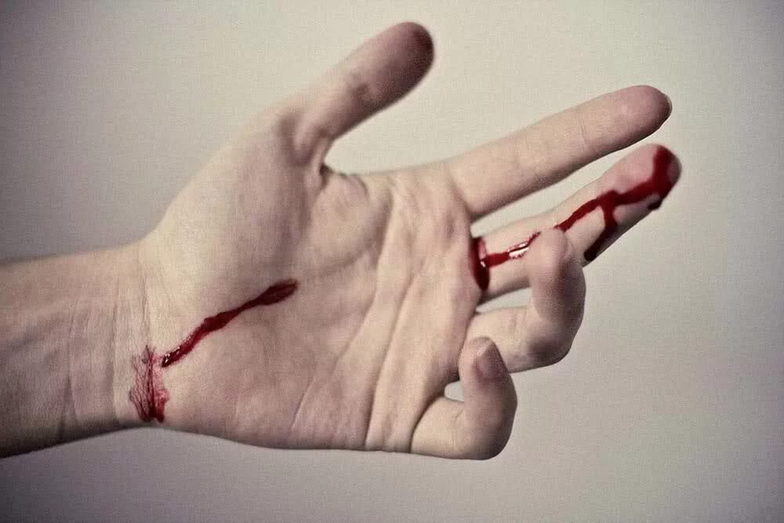
  If there are cuts, abrasions and other skin lesions and if it is not possible to avoid dirtying your hands with sputum and other discharge from a patient – wear rubber gloves. After treating a patient disinfect the gloves.
  If biological material contacts your skin – wash it in water with soap and 70% rubbing alcohol.

Slide 16
WHEN WORKING:
it is necessary to perform only the tasks that are assigned to you and if you know how to perform them in a safe manner;
it is forbidden to be distracted by matters and conversations not related to work;
restrict unauthorized persons from entering wards and operating units;
you should use serviceable medical equipment only and use it for its intended purpose;
it is forbidden to work without PPE, in incorrectly worn or damaged PPE.

Slide 17
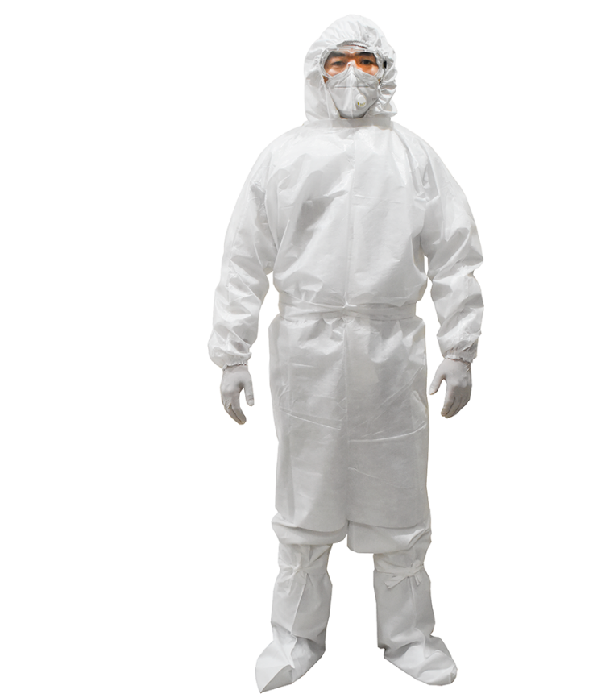
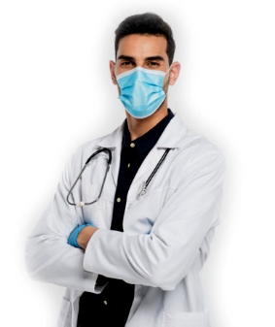
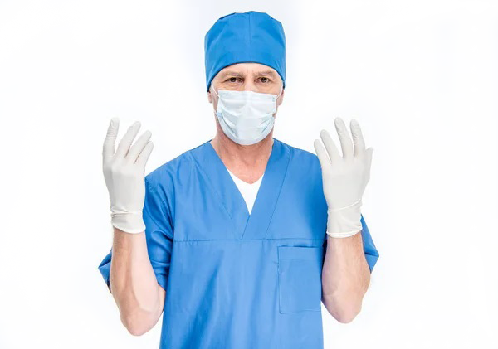
PERSONAL PROTECTIVE EQUIPMENT
PPE should never be neglected.
It is necessary to wear PPE appropriate to the type of work.

Slide 18
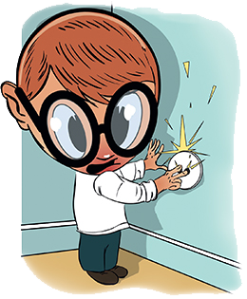
Electrical Safety Requirements:
do not plug in foreign objects into a socket;
do not bend wires;
do not hang anything
over wires;
do not move
operating electrical
appliances ;
do not plug in electrical
appliances with wet hands;

Slide 19
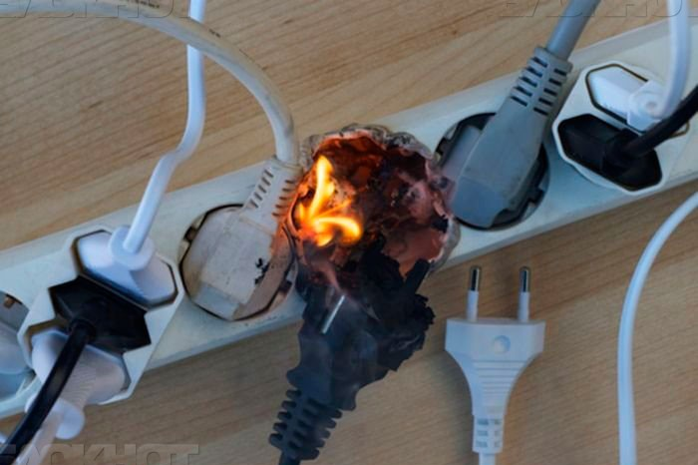
Electrical Safety Requirements
do not use faulty plugs and sockets;
do not leave electrical appliances unattended;
do not pull the cord when trying to disconnect the device from the network;
do not turn on a large number of electrical appliances in one outlet through 3-socket network splitter and
extension cords.

Slide 20
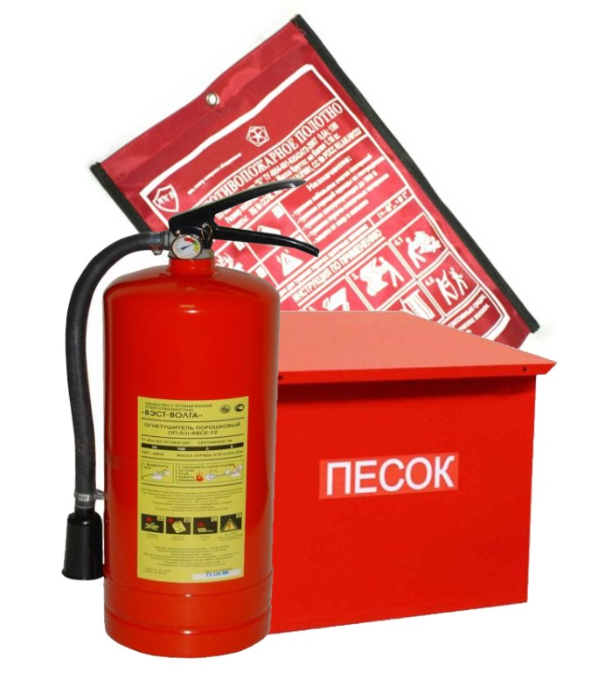

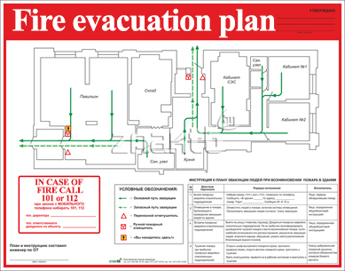
FIRE SAFETY MEASURES
Study:
evacuation plan
emergency exits location
firefighting means locations

Slide 21
FIRE SAFETY MEASURES
IT IS FORBIDDEN TO:
smoke in rooms of a healthcare institution and on its territory;
use faulty electrical appliances;
use electrical heaters with an open spiral;
store flammable substances in inappropriate places;
make an open fire in the building and on the territory.

Slide 22

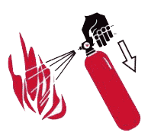
IF FIRE STARTS:
call the fire brigade;
inform the supervisor;
evacuate people;
if necessary start putting off the fire;
IN CASE OF FIRE CALL
101 or 112

Slide 23
EMERGENCIES
If there is a dangerous work environment:
a smell of smoke and fire;
increased heat generation from equipment;
increased noise level at equipment operation;
ground faults, power cuts;
ignition of materials and equipment,
smell of gas, etc.
you should immediately stop working, turn off the equipment, report the incident to the immediate supervisor.

Slide 24
IN CASE OF ACCIDENT (TRAUMA):
stop exposure to the traumatic factor;
assess the condition of the victim, provide first aid, call an ambulance;
report the incident to your supervisor or other person in charge;
if the accident has happened to trainees themselves, they should, if possible, call for help, report the accident to the immediate supervisor or ask someone around to do it;
in case of emergencies and accidents at place of practical training, it is necessary to ensure the safety of the environment before the start of the investigation if this does not pose a danger to the life and health of people and does not lead to an accident.

Slide 25
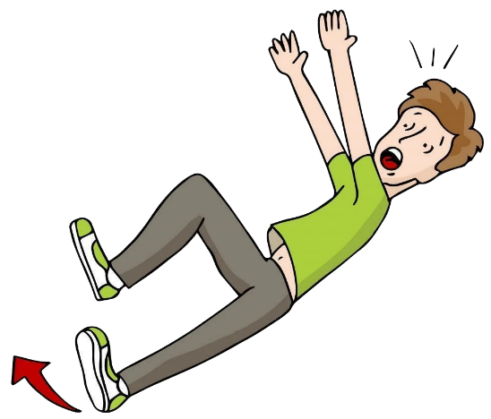
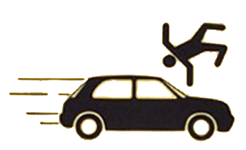
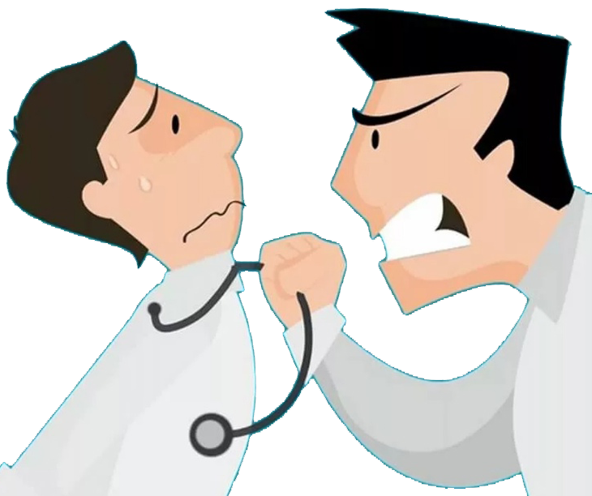
ACCIDENTS AND THEIR CAUSES
Fall when moving – uneven (damaged, slippery) surface, inappropriate footwear, personal negligence.
Road traffic accident (vehicle accident, collision with a pedestrian) –violation of traffic laws, inattention.
Illegal actions of third parties – aggression and (or) intoxicated patients and their relatives.

Slide 26
By following these
simple rules
you will avoid
emergency situations
and protect your
HEALTH

Slide 27


