Slide 1

Are you undergoing practical training?
First undergo safety instructions

Slide 2

Study the instruction on labor safety at the University website, page “Practical training”

Slide 3


Persons allowed practical training:
18 years old and older;
with corresponding education and training;
undergone medical checkup, without any medical contraindications;

Slide 4


Undergone the introductory labor safety training
Undergone the primary training on labor safety at workplace

Slide 5
AT TRAINING, A STUDENT IS ELIGIBLE:
to have a workplace corresponding to the requirements of labor safety;
to be educated on safety methods and approaches to work performance;
to be provided with necessary protective means;
to receive reliable information on conditions and labor safety at the workplace, on harmful and (or) dangerous workplace factors, protective means against their effects;

Slide 6

AT TRAINING, A STUDENT IS ELIGIBLE:
to refuse to perform assigned tasks in case of a danger to own and others life or health until the danger is eliminated, and if individual protective means that ensure safety of work are not provided .
If you refuse to perform assigned tasks due to the reasons above, submit a written notice to the supervisor where you mention the reasons for refusal.

Slide 7
AT TRAINING,
A STUDENT MUST:
follow the labor safety requirements as well as rules of behavior on healthcare institutions’ territory;
know main harmful factors that can arise at practical training as well as preventive and protective measures against them;
use and apply individual and common protective means correctly;

Slide 8
AT TRAINING,
A STUDENT MUST:
care for own safety and health as well as for those of others while working or while on the healthcare institution territory;
know and follow the requirements of fire safety measures, the procedure in case of fire;
inform the supervisor about any life or health threatening situation, accident immediately.

Slide 9


It is unacceptable to be at the workplace in a state of alcoholic intoxication or in a state caused by narcotic substances, psychotropic or toxic substances, as well as to drink alcoholic beverages, take narcotic drugs, psychotropic or toxic substances at the workplace or within working hours.

Slide 10
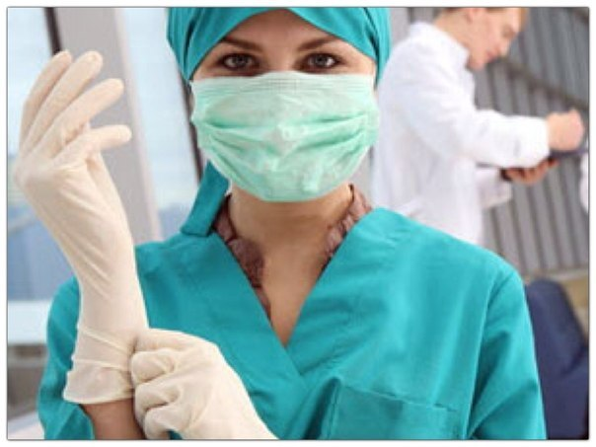
Before work, a student must:
put on sanitary clothes and shoes
that should be clean and do not
constrain motion, put hair
under a cap.
It is not allowed to pin the
clothes with needles, store pins,
keep glass and sharp objects in pockets.
examine and clean the workplace. Remove unnecessary objects that may interfere with the work or create an additional danger.

Slide 11
If individual protective means are absent or there are malfunctions
Report this to your immediate or superior supervisor.
Do not independently eliminate disturbances related to the repair and adjustment of equipment. Repair of equipment is carried out only by specialists.
Do not start work until the problem is fixed.

Slide 12

LABOR
PROTECTION REQUIREMENTS
WHEN
PERFORMING
WORK

Slide 13

Hands
No accessories (rings, bracelets)
Nails should be shortly cut
All injuries should be covered with a plaster or fingerstall
Hands should be washed after a procedure twice

Slide 14
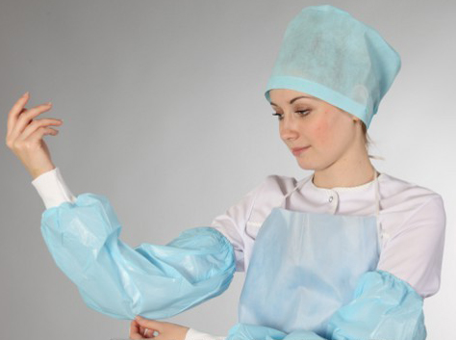

When drawing samples and administering injections use:
  sanitary and hygiene clothes:
      robe;
      cap;
      apron;
      sleeves.
  individual protective means :
      gloves;
      mask;
      protective glasses.

Slide 15

WHEN ADMINISTERING INJECTIONS:
check notes in the administering register;
wash your hands properly;
take on the gloves;
read the bottle or ampoule label
carefully;
check the sell-by date.
open the bottle or ampoule
carefully .

Slide 16
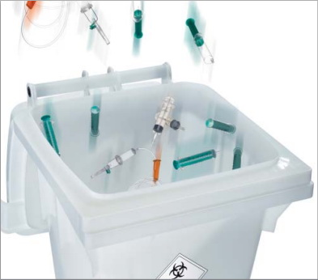
Single use objects:
    syringes,
    medical dressing,
    gloves,
    masks
MUST BE DISPOSED IN ACCORDANCE WITH DISPOSAL RULES.

Slide 17
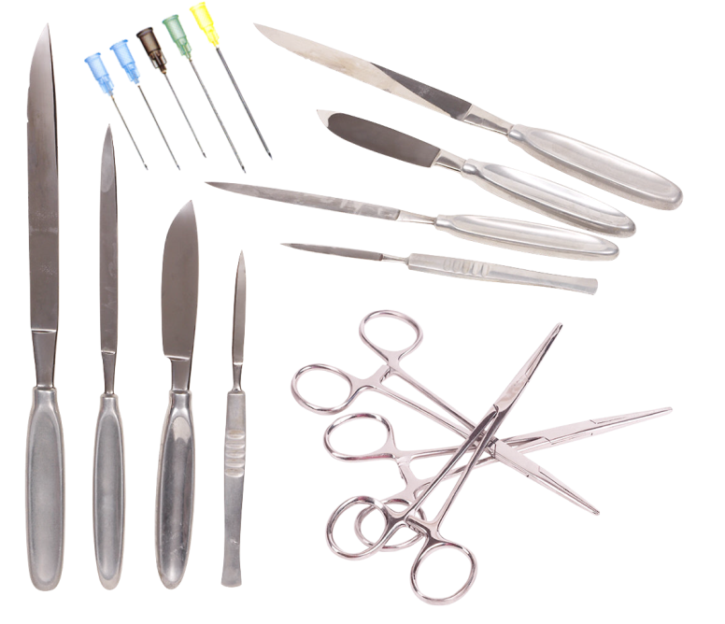
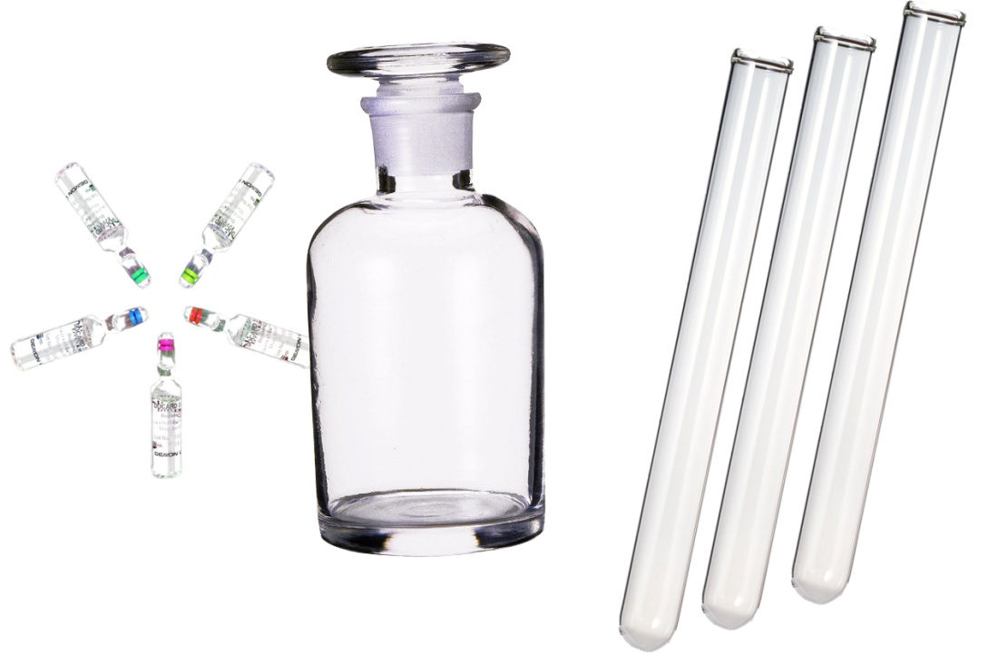
BE ATTENTIVE
when working with piercing and cutting objects (needles, scalpels, scissors, etc.)
when working with glassware
(ampoules, bottles,
vials, test-tubes, etc.)

Slide 18
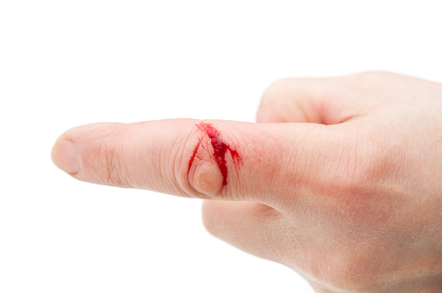
SKIN LESIONS
Wash your hands with a soap without removing gloves;
Remove gloves;
Do not stop blood within several seconds;
Use 70% diethyl hydrine;
Then use 5% iodine alcoholate;
Use a plaster;
Take on a fingerstall if you have a finger wound.

Slide 19
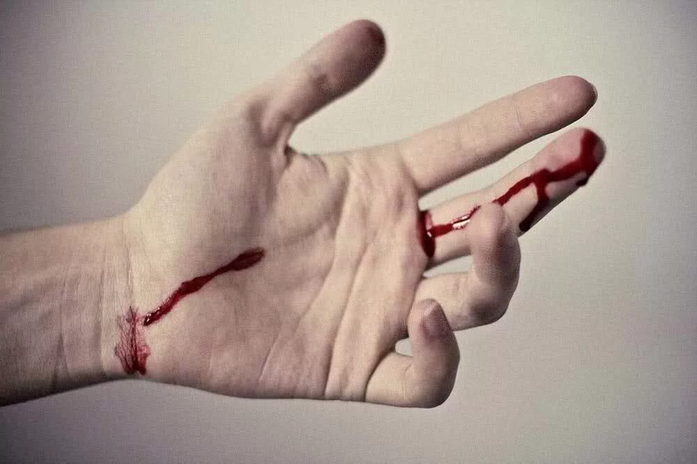
IF A BIOLOGICAL SUBSTANCE GETS ONTO THE SKIN
  Wash with water and soap
  Use 70% diethyl hydrine

Slide 20

WHEN GIVING REMEDIES:
wash your hands carefully;
examine the doctor’s prescription attentively;
be sure all remedies are wrapped in original packs;
check the sell-by date.

Slide 21

WHEN GIVING REMEDIES:
do not allow strangers near remedies;
do not leave remedies unattended;
it is absolutely forbidden
to taste remedies.

Slide 22
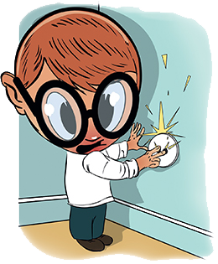
Electrical Safety Requirements:
do not plug in foreign objects into a socket;
do not bend wires;
do not hang anything
over wires;
do not move
operating electrical
appliances ;
do not plug in electrical
appliances with wet hands;

Slide 23
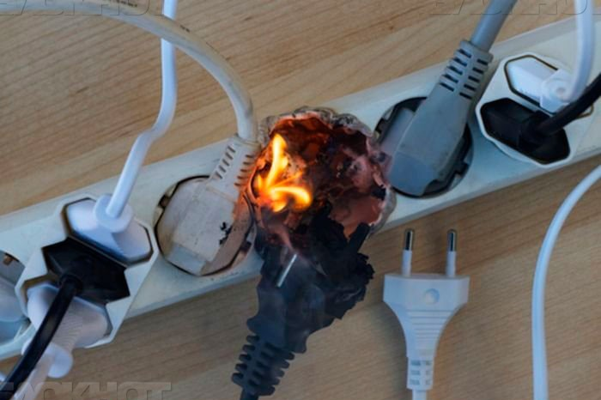
Electrical Safety Requirements
do not use faulty plugs and sockets;
do not leave electrical appliances unattended;
do not pull the cord when trying to disconnect the device from the network;
do not turn on a large number of electrical appliances in one outlet through 3-socket network splitter and
extension cords.

Slide 24


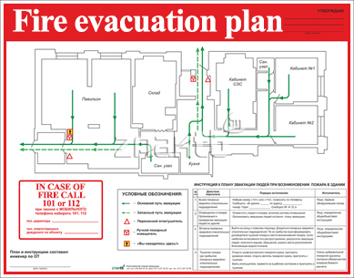
FIRE SAFETY MEASURES
Study:
evacuation plan
emergency exits location
firefighting means locations

Slide 25
FIRE SAFETY MEASURES
IT IS FORBIDDEN TO:
smoke in rooms of a healthcare institution and on its territory;
use faulty electrical appliances;
use electrical heaters with an open spiral;
store flammable substances in inappropriate places;
make an open fire in the building and on the territory.

Slide 26


IF FIRE STARTS:
call the fire brigade;
inform the supervisor;
evacuate people;
if necessary put off the fire.
IN CASE OF FIRE CALL
101 or 112

Slide 27
EMERGENCIES
If there is a dangerous work environment:
a smell of smoke and fire;
increased heat generation from equipment;
increased noise level at equipment operation;
ground faults, power cuts;
ignition of materials and equipment,
smell of gas, etc.
you should immediately stop working, turn off the equipment, report the incident to the immediate supervisor.

Slide 28
IN CASE OF ACCIDENT (TRAUMA):
stop exposure to the traumatic factor;
assess the condition of the victim, provide first aid, call an ambulance;
report the incident to your supervisor or other person in charge;
if the accident has happened to trainees themselves, they should, if possible, call for help, report the accident to the immediate supervisor or ask someone around to do it;
in case of emergencies and accidents at place of practical training, it is necessary to ensure the safety of the environment before the start of the investigation, if this does not pose a danger to the life and health of people and does not lead to an accident.

Slide 29
By following these
simple rules
you will avoid
emergency situations
and protect your
HEALTH

Slide 30


